Slide 1
Artificial Neural Networks

Slide 2
Learning Objectives
Fundamentals of ANN
Comparison between biological neuron and artificial neuron
Basic models of ANN
Different types of connections of NN, Learning and activation function
Basic fundamental neuron model-McCulloch-Pitts neuron, Perceptron and Multilayer Perceptron

Slide 3
Fundamental concept
ANN are constructed and implemented to model the human brain.
Performs various tasks such as pattern-matching, classification, optimization function, approximation and data clustering.
These tasks are difficult for traditional computer programs.

Slide 4
ANN
ANN possess a large number of processing elements called nodes/neurons which operate in parallel.
Neurons are connected with others by connection link.
Each link is associated with weights which contain information about the input signal.
Each neuron has an internal state of its own which is a function of the inputs that neuron receives- Activation level.

Slide 5

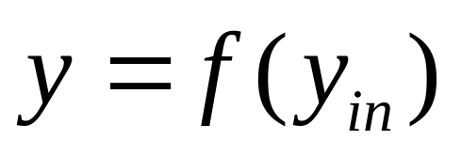
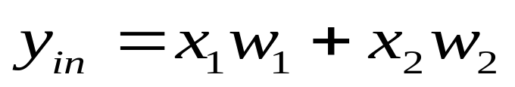
Artificial Neural Networks
x₁
X₁
w₁
Y
y
x₂
w₂
X₂

Slide 6
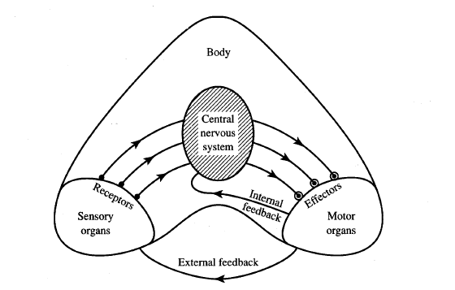
Information flow in nervous system

Slide 7
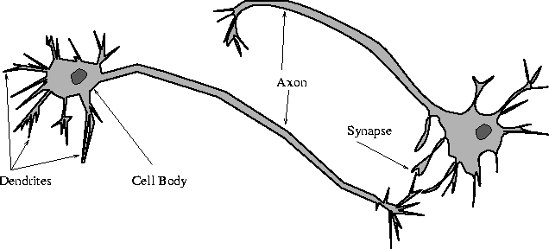
Biological Neural Network

Slide 8
Biological Neuron
Has 3 parts
  Soma or cell body: cell nucleus is located
  Dendrites: nerve connected to cell body
  Axon: carries impulses of the neuron
End of axon splits into fine strands
Each strand terminates into a bulb-like organ called synapse
Electric impulses are passed between the synapse and dendrites
Synapses are of two types
  Inhibitory:- impulses hinder the firing of the receiving cell
  Excitatory:- impulses cause the firing of the receiving cell
Neuron fires when the total of the weights to receive impulses exceeds the threshold value during the latent summation period

Slide 9
Comparison between brain verses computer
 | Brain | ANN
Speed | Few ms. | Few nano sec. massive ||el processing
Size and complexity | 10¹¹ neurons & 10¹⁵ interconnections | Depends on designer
Storage capacity | Stores information in its interconnection or in synapse. No Loss of memory | Contiguous memory locations loss of memory may happen sometimes.
Tolerance | Has fault tolerance | No fault tolerance It gets disrupted when interconnections are disconnected
Control mechanism | Complicated involves chemicals in biological neuron | Simpler in ANN

Slide 10
Features of McCulloch-Pitts model (1943)
Allows binary 0,1 states only
Operates under a discrete-time assumption
Weights and the neurons’ thresholds are fixed in the model and no interaction among network neurons.
Just a primitive model.

Slide 11
Basic models of ANN
Basic Models of ANN
Interconnections
Learning rules
Activation function

Slide 12
Classification based on interconnections
Interconnections
Feed forward
Feed Back
Recurrent
Single layer
Multilayer
Single layer
Multilayer

Slide 13
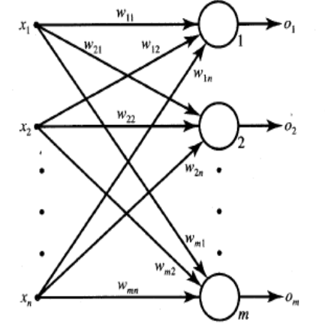
Single layer Feedforward Network

Slide 14
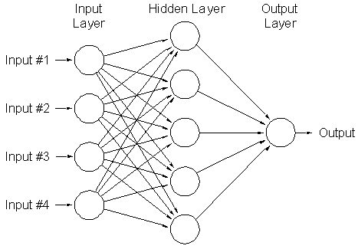
Multilayer feed forward network
Can be used to solve complicated problems

Slide 15
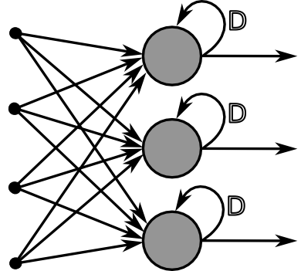
Recurrent Networks

Slide 16
Basic models of ANN
Basic Models of ANN
Interconnections
Learning rules
Activation function

Slide 17
Learning
It’s a process by which a NN adapts itself to a stimulus by making proper parameter adjustments, resulting in the production of desired response.
2. Two kinds of learning
    Parameter learning:- connection weights are updated
    Structure Learning:- change in network structure

Slide 18
Training
The process of modifying the weights in the connections between network layers with the objective of achieving the expected output is called training a network.
This is achieved through
    Supervised learning
    Unsupervised learning
    Reinforcement learning

Slide 19
Classification of learning
Supervised learning
Unsupervised learning
Reinforcement learning

Slide 20
Supervised Learning
Child learns from a teacher
Each input vector requires a corresponding target vector.
Training pair=[input vector, target vector]
Neural
Network
W
X
Y
(Input)
(Actual output)
Error
(D-Y) signals
Error
Signal
Generator
(Desired Output)

Slide 21
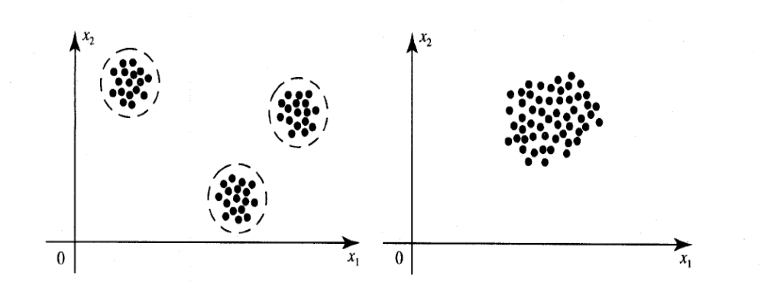
Unsupervised Learning
How a fish or tadpole learns
All similar input patterns are grouped together as clusters.
If a matching input pattern is not found a new cluster is formed

Slide 22
Reinforcement Learning
X
NN
W
Y
(Input)
(Actual output)
Error
signals
Error
Signal
Generator
R
Reinforcement signal

Slide 23
When Reinforcement learning is used?
If less information is available about the target output values (critic information)
Learning based on this critic information is called reinforcement learning and the feedback sent is called reinforcement signal

Slide 24
Basic models of ANN
Basic Models of ANN
Interconnections
Learning rules
Activation function

Slide 25
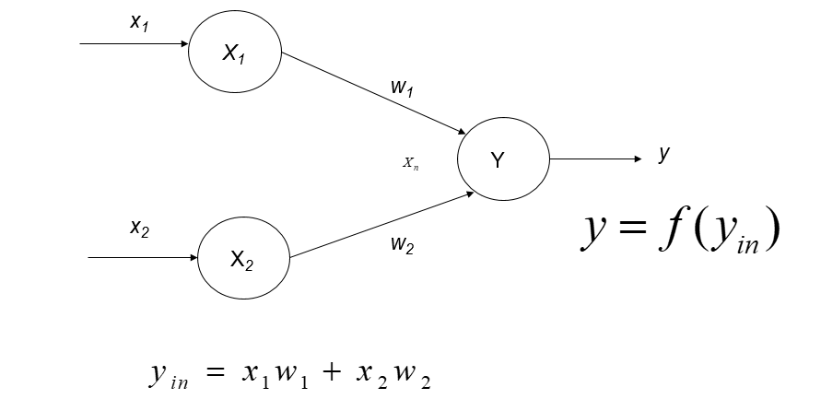
Activation Functions
An activation function is a mathematical formula applied to a neuron's weighted input to determine whether and how much the signal should pass to the next layer.

Slide 26
Activation Functions
Linear
f( 𝑥) = 𝑎𝑥 + b
  2. Non Linear Functions:
  Sigmoid (Logistic)
  Hyperbolic Tangent (Tanh)
  Rectified Linear Unit (ReLU)
  a. Leaky Relu
  Softmax

Slide 27
Important terminologies of ANNs
Weights
Bias
Threshold
Learning rate

Slide 28
Weights
Each neuron is connected to every other neuron by means of directed links
Links are associated with weights
Weights contain information about the input signal and is represented as a matrix
Weight matrix also called connection matrix

Slide 29
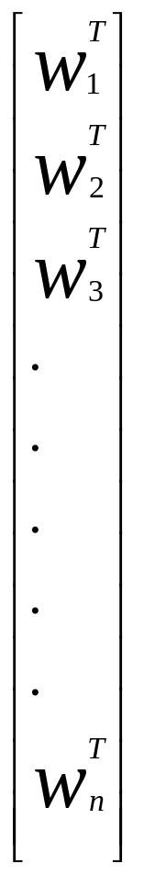
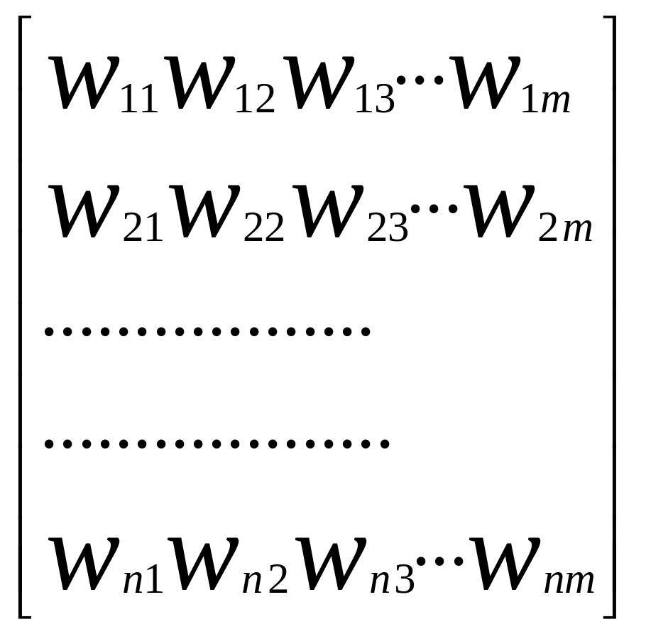
Weight matrix
W=
=

Slide 30
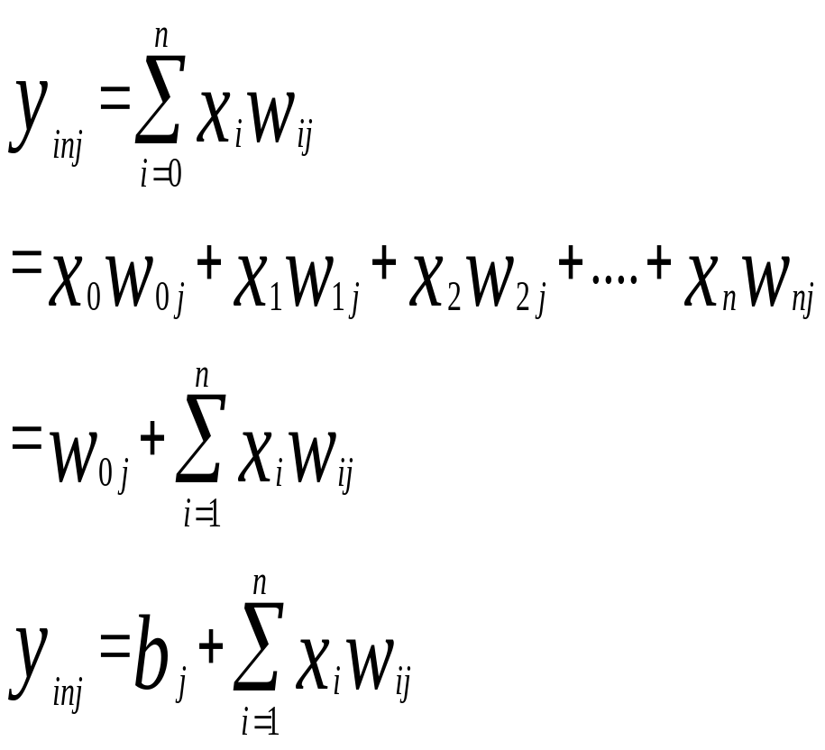
Weights contd…
w_{ij –}is the weight from processing element ”i” (source node) to processing element “j” (destination node)
1
X₁
b_{j}
w_{1j}
X_{i}
Y_{j}
w_{ij}
X_{n}
w_{nj}

Slide 31
Bias
Bias is like another weight. Its included by adding a component x₀=1 to the input vector X.
X=(1,X₁,X₂…X_{i},…X_{n})
Bias is of two types
    Positive bias: increase the net input
    Negative bias: decrease the net input

Slide 32
Why Bias is required?
The relationship between input and output given by the equation of straight line y=mx+c
C(bias)
Input
X
Y
y=mx+C

Slide 33
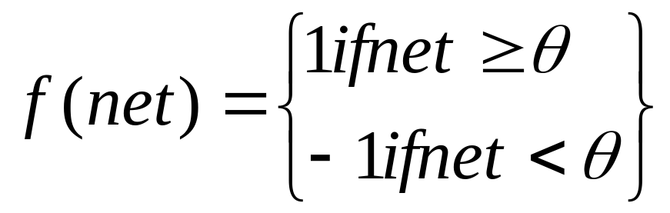
Threshold
Set value based upon which the final output of the network may be calculated
Used in activation function
The activation function using threshold can be defined as

Slide 34
Learning rate
Denoted by α.
Used to control the amount of weight adjustment at each step of training
Learning rate ranging from 0 to 1 determines the rate of learning in each time step

Slide 35
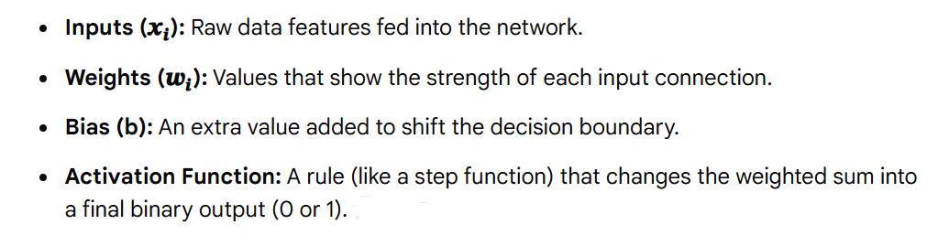
Single Layer Perceptron
A single-layer perceptron is the simplest type of artificial neural network used for binary classification of linearly separable patterns.

Slide 36
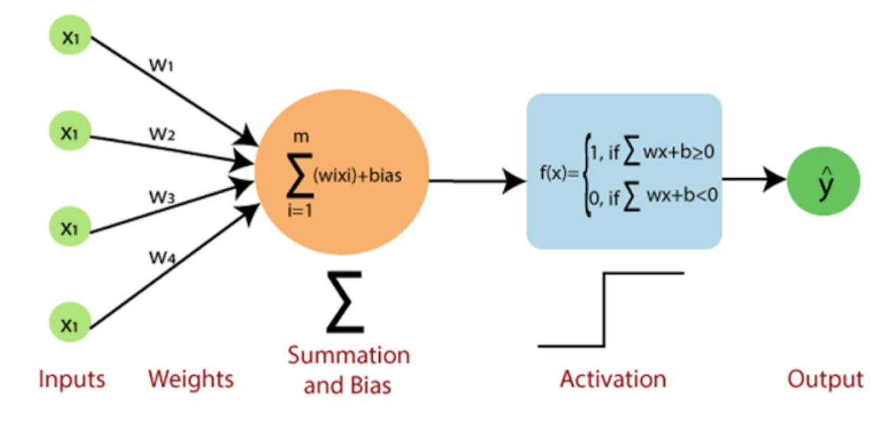
Single Layer Perceptron

Slide 37
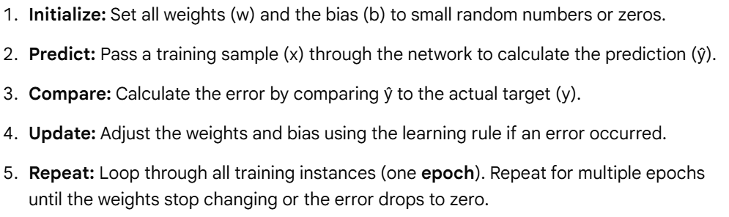
Perceptron Learning Rule

Slide 38
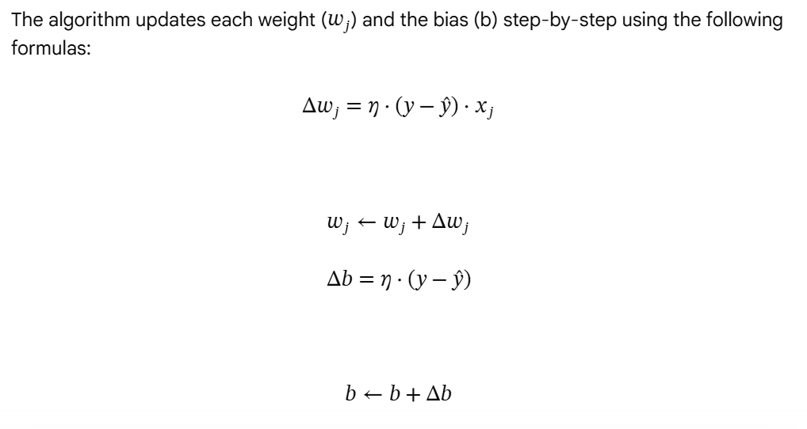
Perceptron Learning Rule

Slide 39
Logical AND
x1 | x2 | y
1 | 1 | 1
1 | 0 | 0
0 | 1 | 0
0 | 0 | 0

Slide 40
Multi Layer Perceptron
What is it? A class of feedforward Artificial Neural Network (ANN) that contains one or more layers of hidden units.
Evolution: Developed to overcome the strict linear limitations of Single-Layer Perceptrons.
The Core Power: Functions as a Universal Approximator, meaning it can model virtually any complex, non-linear relationship between inputs and outputs.

Slide 41
Architecture of Multilayer Perceptron
Unlike an SLP, an MLP is composed of at least three layers of fully connected nodes:
Input Layer: Receives the raw feature data. Passes it forward without changing it.
Hidden Layer(s): The "brains" of the network. One or more layers that extract abstract features and patterns from data.
Output Layer: Produces the final prediction (e.g., probability scores, continuous values, or multiple classes).

Slide 42
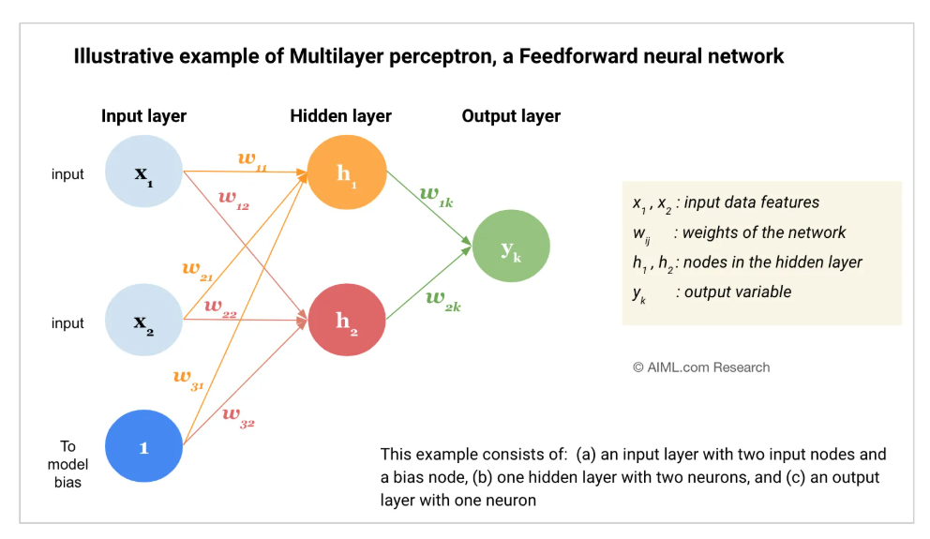
Architecture of Multilayer perceptron

Slide 43
Working
Forward propagation: Data moves from input to output, making a prediction.
Loss calculation: The network compares its prediction to the real target value to find the error.
Backpropagation: The error travels backward through the layers using the chain rule to update weights and biases via gradient descent.

Slide 44
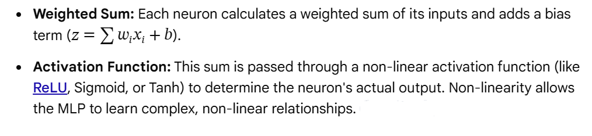
Forward propagation
Data flows sequentially in one direction through the fully connected layers—from the input layer, through the hidden layers, to the output layer.

Slide 45
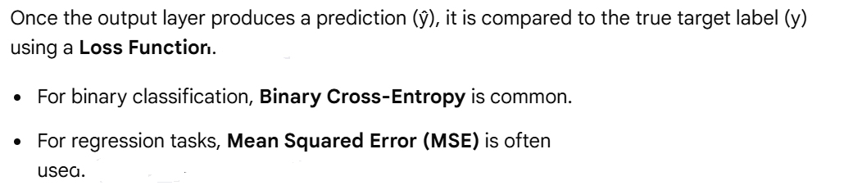
Loss Function Evaluation (Measuring Error)

Slide 46
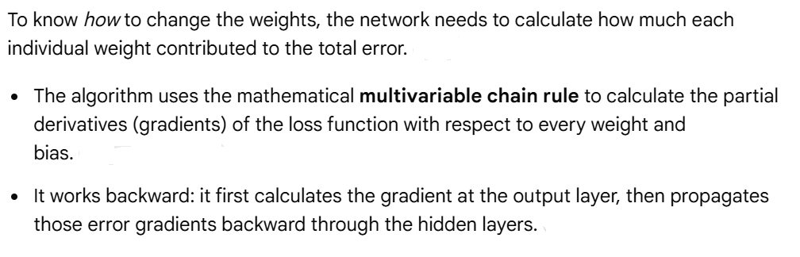
Backpropagation (Distributing the Blame)

Slide 47
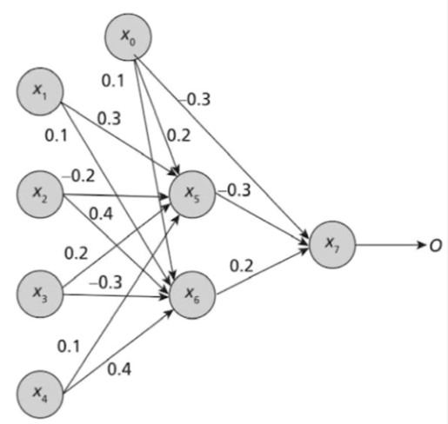
MLP Solved example
alpha=0.8
x1 | x2 | x3 | x4 | y
1 | 1 | 0 | 1 | 1

Slide 48

Weight updation
Using the calculated gradients, an optimizer shifts the weights in the opposite direction of the gradient to reduce the overall error. The standard formula using Stochastic Gradient Descent (SGD) is
Where α (alpha) is the Learning Rate—a hyperparameter that controls how large of a step the algorithm takes toward minimizing the error.

Slide 49

Logical XOR
X1 | X2 | Y
1 | 1 | -1
1 | -1 | 1
-1 | 1 | 1
-1 | -1 | -1

Slide 50
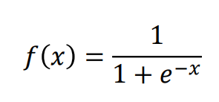
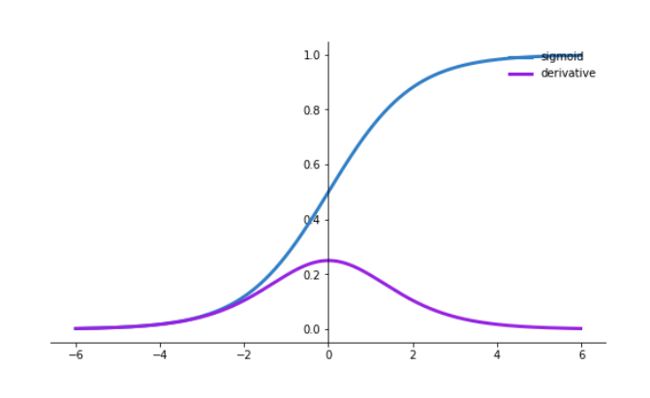
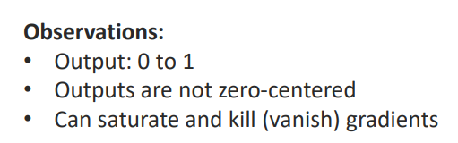
Sigmoid Activation Functions (Logistics)

Slide 51
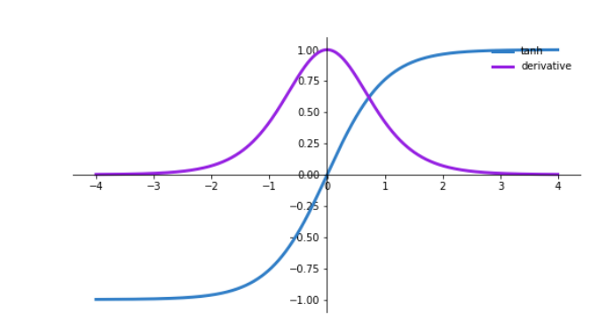

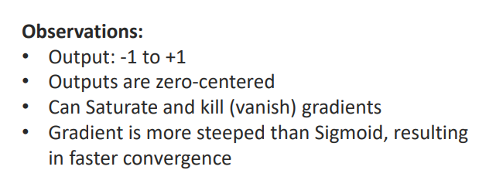
Tanh Activation Function

Slide 52

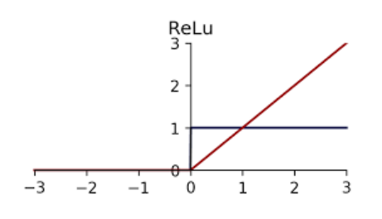
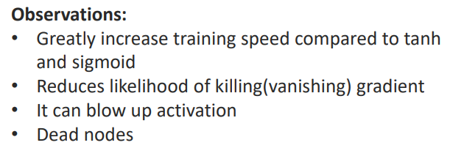
Rectified Linear Unit(ReLU)

Slide 53

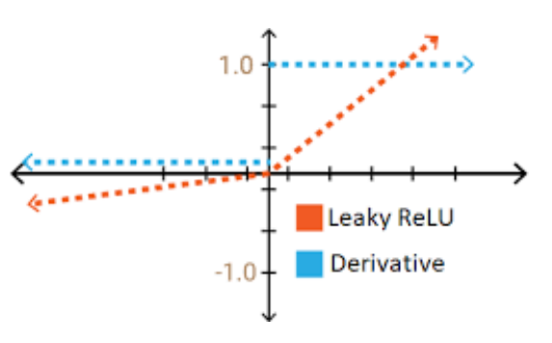
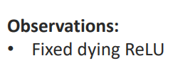
Leaky-ReLU

Slide 54
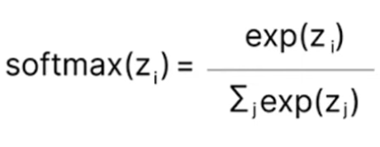
Softmax
Observations:
Range bounds: All resulting output values are strictly positive numbers between 0 and 1.
Probability sum: The sum of all class probabilities in the output vector always equals exactly 1.0.

Slide 55
Loss Function

Slide 56
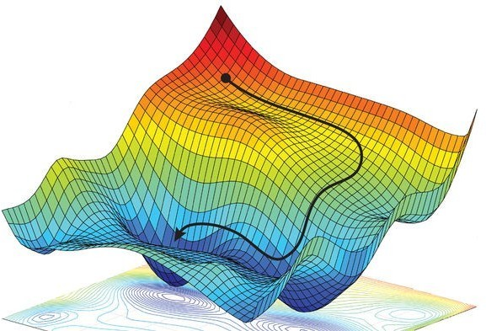
Loss functions

Slide 57
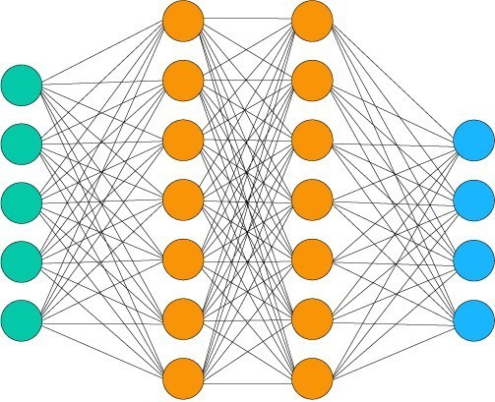
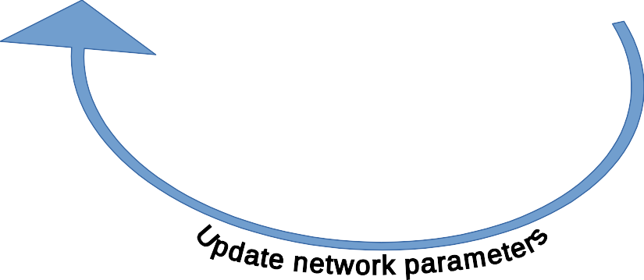
Loss functions
How good is your neural network?
Inputs
e.g.
●
Image (pixel values) Sentence (encoded) State (for RL)
Inputs
●
Outputs
●
Loss
Targets
e.g.
Targets
●
‘Cat’/’Dog’ (encoded) Next word (encoded) TD(0) (for RL)
●
●

Slide 58
Loss functions
Some pedantry
Loss function and Cost function are often used interchangeably but they are different:
●
The loss function measures the network performance on a single datapoint The cost function is the average of the losses over the entire training dataset
●
Our goal is to minimize the cost function.
In reality, we actually use batch losses as a proxy for the cost function.

Slide 59
Loss/Cost functions
Some stuff to remember
●
The cost function distils the performance of the network down to a single scalar number. Generally (although not necessarily) loss ≥ 0 (so cost ≥ 0 also)
●
cost=0 ⇒ perfect performance (on the given dataset)
●
●
The lower the value of the cost function, the better the performance of the network.
●
Hence gradient descent
●
A cost function must faithfully represent the purpose of the network.

Slide 60

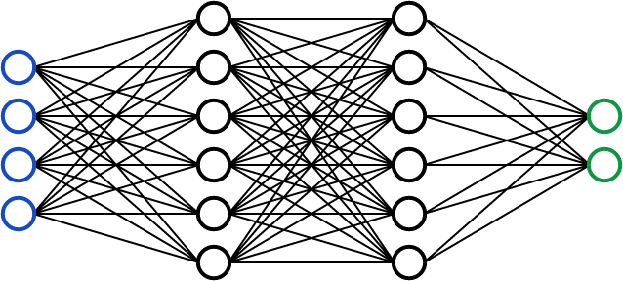
Loss/Cost functions
Some stuff to remember
●
The cost function distils the performance of the network down to a single scalar number. Generally (although not necessarily) loss ≥ 0 (so cost ≥ 0 also)
●
cost=0 ⇒ perfect performance (on the given dataset)
●
●
The lower the value of the cost function, the better the performance of the network.
●
Hence gradient descent
●
A cost function must faithfully represent the purpose of the network.
cat
0.85
0.15
Accuracy: 1
Loss (CCE): 0.07
dog

Slide 61
Loss/Cost functions
Loss functions
●
Classification
●
Maximum likelihood
Binary cross-entropy (aka log loss) Categorical cross-entropy
●
●
●
Regression (i.e. function approximation)
●
Mean Squared Error Mean Absolute Error Huber Loss
●
●

Slide 62
Classification loss functions
Loss functions
●
Classification
●
Maximum likelihood
Binary cross-entropy (aka log loss) Categorical cross-entropy
●
●

Slide 63
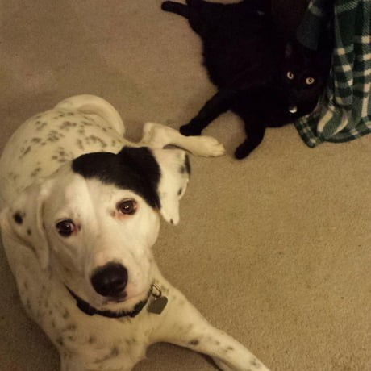
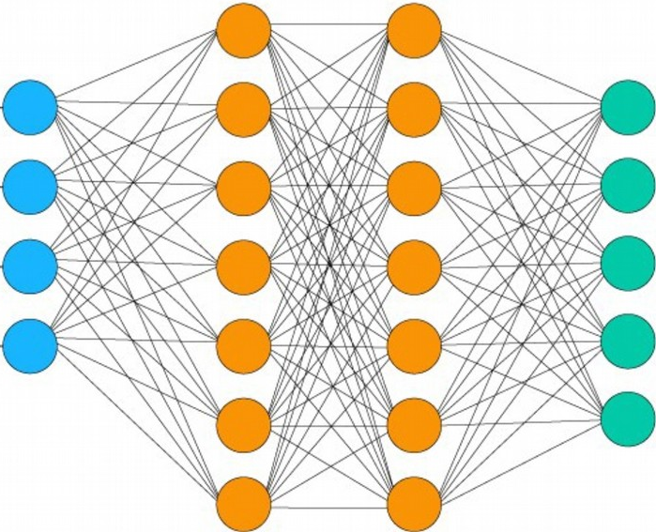
Classification loss functions
Maximum likelihood
Input
Cat
Dog
Bear
Hitler
Putin
(.5, .9, .2, .6, .1)
Target
(1, 1, 0, 0, 0)
Cat -
Dog - Bear - Hitler - Putin -

Slide 64


Classification loss functions
Maximum likelihood
Input
Cat
Dog
Bear
Hitler
Putin
(.5, .9, .2, .6, .1)
Loss =
Target
= –¹/5 [ (1*0.5 + 0*0.5) + (1*0.9 + 0*0.1) + (0*0.2 + 1*0.8)
+ (0*0.6 + 1*0.4) + (0*0.1 + 1*0.9) ]
= –0.7
(1, 1, 0, 0, 0)
Cat -
Dog - Bear - Hitler - Putin -

Slide 65
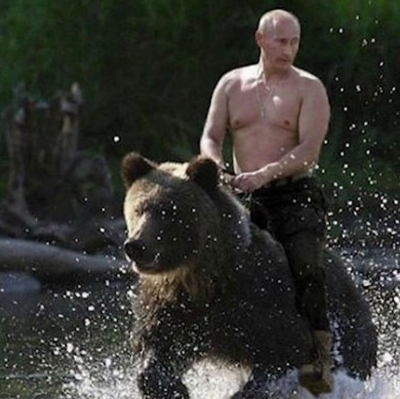

Classification loss functions
Torch.nn.BCELoss
Binary cross-entropy (aka Log loss)
Input
Cat
Dog
Bear
Hitler
Putin
(.2, .4, .8, .3, .9)
Loss =
Target
(0, 0, 1, 0, 1)
Cat -
Dog - Bear - Hitler - Putin -

Slide 66
Classification loss functions
Torch.nn.BCELoss
Binary cross-entropy (aka Log loss)
Input
Cat
Dog
Bear
Hitler
Putin
(.2, .4, .8, .3, .9)
Loss =
Target
= –¹/5 [ (1*log(0.8)) + (1*log(0.6)) + (1*log(0.8))
+ (1*log(0.7)) + (1*log(0.9)) ]
= 0.28
(0, 0, 1, 0, 1)
Cat -
Dog - Bear - Hitler - Putin -

Slide 67
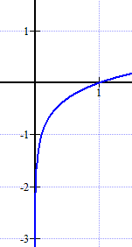
Classification loss functions
y
Binary cross-entropy (aka Log loss)
Torch.nn.BCELoss
p
Input
Cat
Dog
Bear
Hitler
Putin
(.2, .4, .8, .3, .9)
y = p
y = log(p)
Loss =
Target
= –¹/5 [ (1*log(0.8)) + (1*log(0.6)) + (1*log(0.8))
+ (1*log(0.7)) + (1*log(0.9)) ]
= 0.28
(0, 0, 1, 0, 1)
Cat -
Dog - Bear - Hitler - Putin -

Slide 68



Classification loss functions
Categorical cross-entropy
Torch.nn.NLLLoss
Torch.nn.CrossEntropyLoss
Input
This one does the softmax for you
Cat
Dog
Bear
Hitler
Putin
(.8, 0, 0, .2, 0)
Must be a probability distribution
Loss =
Target
= – [ 1*log(0.8) ]
= 0.22
(1, 0, 0, 0, 0)
Cat -
Dog - Bear - Hitler - Putin -

Slide 69
Classification loss functions
Categorical cross-entropy
Torch.nn.NLLLoss
Torch.nn.CrossEntropyLoss
Input
This one does the softmax for you
Cat
Dog
Bear
Hitler
Putin
(.8, 0, 0, .2, 0)
Must be a probability distribution
Loss =
This loss function can also be used when you have a single binary (e.g. yes/no) output
Target
= – [ 1*log(0.8) ]
= 0.22
(1, 0, 0, 0, 0)
Cat -
Dog - Bear - Hitler - Putin -

Slide 70
Regression loss functions
Loss functions
●
Regression (i.e. function approximation)
●
Mean Squared Error Mean Absolute Error Huber Loss
●
●

Slide 71
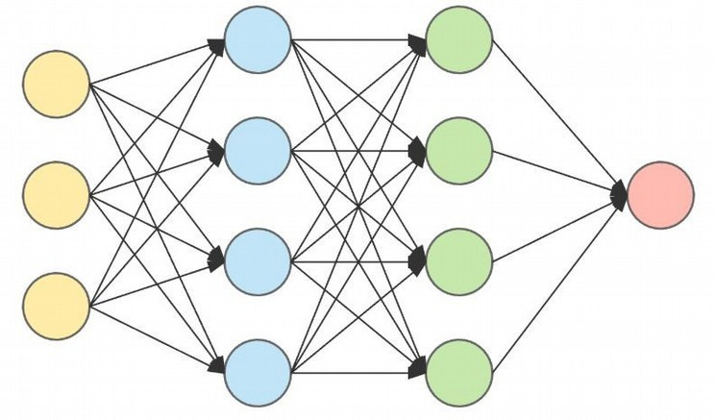


Regression loss functions
aka L2 loss
Mean squared error
Input
Torch.nn.MSELoss
Target
Loss

Slide 72
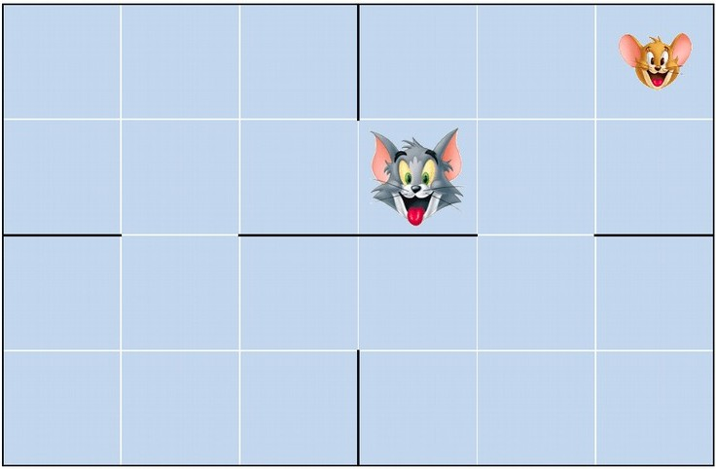



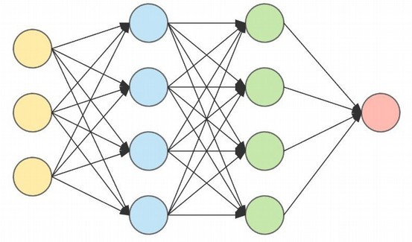

Regression loss functions
aka L2 loss
Mean squared error
Input
Torch.nn.MSELoss
Q(St,At)
state St & action At
Target
reward Rt+1
Q(St+1,At+1)
state St+1 & [best] action At+1

Slide 73


Regression loss functions
aka L2 loss
Mean squared error
Torch.nn.MSELoss
Loss
Q(St,At)
Input
Q(St,At)
state St & action At
Target
reward Rt+1
Q(St+1,At+1)
state St+1 & [best] action At+1

Slide 74

Regression loss functions
aka L1 loss
Absolute error
Input
Torch.nn.L1Loss
Target
Loss

Slide 75
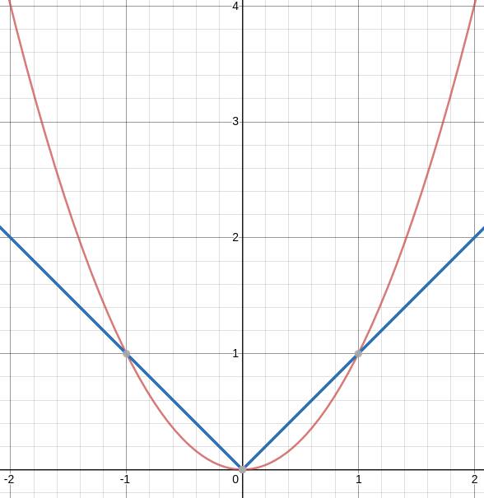
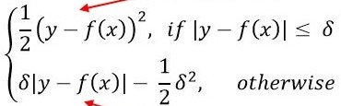
Regression loss
Huber loss combines the best features of MSE and AE:
like MSE for small errors.
like AE otherwise.
Huber loss
This avoids over-shooting:
MSE has a very steep gradient when the error is large (i.e. for outliers) because of its quadratic form.
AE has a steep gradient when
the error is small because it doesn’t have a ‘flat’ bottom.
Torch.nn.SmoothL1Loss
Input
loss
Target
Loss
error

Slide 76
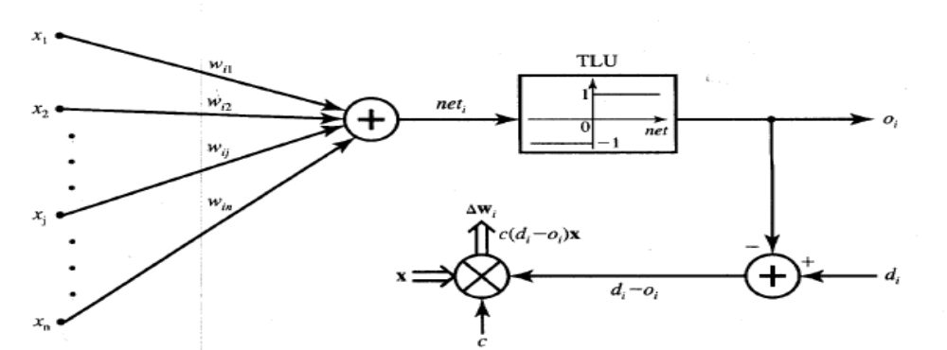
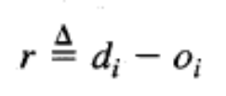

Perceptron Learning rule
Learning signal is the difference between the desired and actual neuron’s response
Learning is supervised

Slide 77
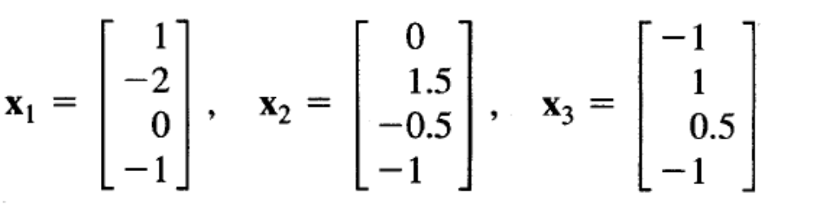
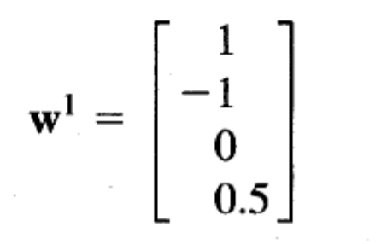

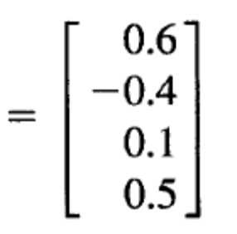


Slide 78
Linear Separability
Separation of the input space into regions is based on whether the network response is positive or negative
Line of separation is called linear-separable line.
Example:-
  AND function & OR function are linear separable Example
  EXOR function Linearly inseparable. Example

Slide 79
Gradient Descent and the Delta Learning Rule
Core Objective: Adjusting network weights to minimize prediction errors. [1, 2]
The Learning Process:
  Input data is fed into the network.
  The network generates an output.
  Output is compared against the actual target.
  Weights are adjusted based on the error. [1, 2]

Slide 80
Understanding the Error Surface
Cost Function (E): A mathematical metric (like Mean Squared Error) that quantifies how "wrong" the model is.
The Goal: Find the global minimum where the error is closest to zero.
Visualizing the Surface: Imagine a 3D bowl-shaped landscape where altitude represents the error magnitude. [1, 2]

Slide 81
What is Gradient Descent?
Definition: An iterative optimization algorithm used to minimize a cost function.
The Core Concept: Moving step-by-step in the direction of the steepest descent on the error surface.
The Gradient (∇ E): A vector of partial derivatives pointing toward the steepest ascent.
Descent Rule: Move in the negative direction of the gradient (-∇ E). [1, 2, 3, 4, 5]

Slide 82
The Math Behind Gradient Descent
Weight Update Formula:
\(w_{new}=w_{old}-\eta \nabla E\)
Key Parameters:
w: The weight vector being optimized.
η (Eta): The Learning Rate (controls the step size). [1, 2]
The Trade-off:
Too large η: Overshoots and oscillates.
Too small η: Takes too long to converge. [1, 2, 3, 4]

Slide 83
What is the Delta Learning Rule?
Definition: A specific application of gradient descent used for training single-layer neural networks (Perceptrons/Adaline).
Alternative Name: Widrow-Hoff Rule or Least Mean Squares (LMS) learning rule.
Core Principle: The adjustment made to a weight is proportional to the difference between the target output and the actual output. [1, 2, 3, 4, 5]

Slide 84
Mathematical Formulation of Delta Rule
Error for a Single Layer:
\(E=\frac{1}{2}(t-y)^{2}\)
(where t is target output and y is actual linear output)
The Delta Weight Update:
\(\Delta w_{i}=\eta (t-y)x_{i}\)
Components:
(t - y): The error (Delta).
\(x_{i}\): The input value associated with weight \(w_{i}\).

Slide 85
Delta Rule vs. Perceptron Learning Rule
Perceptron Rule: Updates weights based on a hard threshold output (binary classification like 0 or 1). It only updates if the final output is wrong. [1]
Delta Rule: Updates weights based on the continuous, linear output before any hard thresholding. It continuously minimizes the overall mean square error. [1, 2, 3]

Slide 86
Feed-Forward Networks
Predictions are fed forward through the network to classify

Slide 87
Feed-Forward Networks
Predictions are fed forward through the network to classify

Slide 88
Feed-Forward Networks
Predictions are fed forward through the network to classify

Slide 89
Feed-Forward Networks
Predictions are fed forward through the network to classify

Slide 90
Feed-Forward Networks
Predictions are fed forward through the network to classify

Slide 91
Feed-Forward Networks
Predictions are fed forward through the network to classify

Slide 92
Error Backpropagation
We will do gradient descent on the whole network.
Training will proceed from the last layer to the first.

Slide 93
Error Backpropagation
Introduce variables over the neural network
Notes:
\vec{\theta}=\{w_{ij}, w_{jk}, w_{kl}\}

Slide 94
Error Backpropagation
Introduce variables over the neural network
  Distinguish the input and output of each node
Notes:
\vec{\theta}=\{w_{ij}, w_{jk}, w_{kl}\}

Slide 95



Error Backpropagation
Notes:
\vec{\theta}=\{w_{ij}, w_{jk}, w_{kl}\}

Slide 96
Error Backpropagation
Training: Take the gradient of the last component and iterate backwards
Notes:
\vec{\theta}=\{w_{ij}, w_{jk}, w_{kl}\}

Slide 97

Error Backpropagation
Empirical Risk Function

Slide 98


Error Backpropagation
Optimize last layer weights w_{kl}
Calculus chain rule
Notes:
\frac{\partial R}{\partial w_{kl}}=\frac{1}{N}\sum_n\left[\frac{\partial L_n}{\partial a_{l,n}}\right]\left[\frac{\partial a_{l,n}}{\partial w_{kl}}\right]

Slide 99

Error Backpropagation
Optimize last layer weights w_{kl}
Calculus chain rule

Slide 100

Error Backpropagation
Optimize last layer weights w_{kl}
Calculus chain rule

Slide 101
Error Backpropagation
Optimize last layer weights w_{kl}
Calculus chain rule

Slide 102

Error Backpropagation
Optimize last layer weights w_{kl}
Calculus chain rule

Slide 103


Error Backpropagation
Optimize last hidden weights w_{jk}
Notes:
\frac{\partial R}{\partial w_{kl}}=\frac{1}{N}\sum_n\left[\frac{\partial \frac{1}{2}(y_n-g(a_{l,n}))^2}{\partial a_{l,n}}\right]\left[\frac{\partial z_{k,n}w_{kl}}{\partial w_{kl}}\right]&=&\sum_n\left[-(y_n-z_{l,n})g'(a_{l,n})\right]z_{k,n}\\&=&\sum_n\delta_nz_{k,n}

Slide 104

Error Backpropagation
Optimize last hidden weights w_{jk}
Multivariate chain rule
Notes:
\frac{\partial R}{\partial w_{kl}}=\frac{1}{N}\sum_n\left[\frac{\partial \frac{1}{2}(y_n-g(a_{l,n}))^2}{\partial a_{l,n}}\right]\left[\frac{\partial z_{k,n}w_{kl}}{\partial w_{kl}}\right]&=&\sum_n\left[-(y_n-z_{l,n})g'(a_{l,n})\right]z_{k,n}\\&=&\sum_n\delta_nz_{k,n}

Slide 105

Error Backpropagation
Optimize last hidden weights w_{jk}
Multivariate chain rule
Notes:
\frac{\partial R}{\partial w_{kl}}=\frac{1}{N}\sum_n\left[\frac{\partial \frac{1}{2}(y_n-g(a_{l,n}))^2}{\partial a_{l,n}}\right]\left[\frac{\partial z_{k,n}w_{kl}}{\partial w_{kl}}\right]&=&\sum_n\left[-(y_n-z_{l,n})g'(a_{l,n})\right]z_{k,n}\\&=&\sum_n\delta_nz_{k,n}

Slide 106

Error Backpropagation
Optimize last hidden weights w_{jk}
Multivariate chain rule
Notes:
\frac{\partial R}{\partial w_{kl}}=\frac{1}{N}\sum_n\left[\frac{\partial \frac{1}{2}(y_n-g(a_{l,n}))^2}{\partial a_{l,n}}\right]\left[\frac{\partial z_{k,n}w_{kl}}{\partial w_{kl}}\right]&=&\sum_n\left[-(y_n-z_{l,n})g'(a_{l,n})\right]z_{k,n}\\&=&\sum_n\delta_nz_{k,n}

Slide 107

Error Backpropagation
Optimize last hidden weights w_{jk}
Multivariate chain rule
Notes:
\frac{\partial R}{\partial w_{jk}}=\frac{1}{N}\sum_n\left[\sum_l\delta_l w_{kl}g'(a_{k,n})\right]\left[z_{j,n}\right]\\

Slide 108
Error Backpropagation
Repeat for all previous layers
Notes:
\frac{\partial R}{\partial w_{ij}}&=&\frac{1}{N}\sum_n\left[\frac{\partial L_n}{\partial a_{j,n}}\right]\left[\frac{\partial a_{j,n}}{\partial w_{ij}}\right]=\frac{1}{N}\sum_n\left[ \sum_k\delta_{k,n}w_{jk}g'(a_{j,n}) \right]z_{i,n} =\frac{1}{N} \sum_n\delta_{j,n}z_{i,n}

Slide 109

Error Backpropagation
Now that we have well defined gradients for each parameter, update using Gradient Descent
Notes:
\frac{\partial R}{\partial w_{jk}}=\frac{1}{N}\sum_n\left[\sum_l\delta_l w_{kl}g'(a_{k,n})\right]\left[z_{j,n}\right]\\

Slide 110
Error Back-propagation
Error backprop unravels the multivariate chain rule and solves the gradient for each partial component separately.
The target values for each layer come from the next layer.
This feeds the errors back along the network.

Slide 111
Problems with Neural Networks
Interpretation of Hidden Layers
Overfitting

Slide 112
Interpretation of Hidden Layers
What are the hidden layers doing?!
Feature Extraction
The non-linearities in the feature extraction can make interpretation of the hidden layers very difficult.
This leads to Neural Networks being treated as black boxes.

Slide 113


Overfitting in Neural Networks
Neural Networks are especially prone to overfitting.
Recall Perceptron Error
  Zero error is possible, but so is more extreme overfitting
Logistic
Regression
Perceptron

Slide 114
Under fitting in neural network
Underfitting in a neural network happens when the model is too simple or hasn't trained long enough to capture the real patterns in the data. It leads to poor performance and high error rates on both the training set and new, unseen data

Slide 115
Signs of Underfitting
High training loss and high validation or test loss
The model fails to improve further even as training continues
High statistical bias and low variance

Slide 116
Main Causes
Network size is too small (not enough layers or neurons)
Training stopped too early (too few epochs)
Regularization penalty is too strong (like heavy weight decay or dropout)
Input features lack enough information to explain the target

Slide 117
Ways to Fix It
Add more layers or neurons to make the network deeper and wider
Train for more epochs or adjust the learning rate
Reduce or remove aggressive regularization techniques
Add more relevant features or improve data quality

Slide 118
How to solve
X1 | X2 | B | y
1 | 1 | 1 | 1
1 | -1 | 1 | 1
-1 | 1 | 1 | 1
-1 | -1 | 1 | -1
Use bipolar data in the place of binary data
Initially the weights and bias are set to zero
w1=w2=b=0

Slide 119
Inputs |  |  | y | Weight changes |  |  | weights
X1 | X2 | b | Y | W1 | W2 | B | W1(0) | W2(0) | (0)b
1 | 1 | 1 | 1 | 1 | 1 | 1 | 1 | 1 | 1
1 | -1 | 1 | 1 | 1 | -1 | 1 | 2 | 0 | 2
-1 | 1 | 1 | 1 | -1 | 1 | 1 | 1 | 1 | 3
-1 | -1 | 1 | -1 | 1 | 1 | -1 | 2 | 2 | 2

